Slide 1
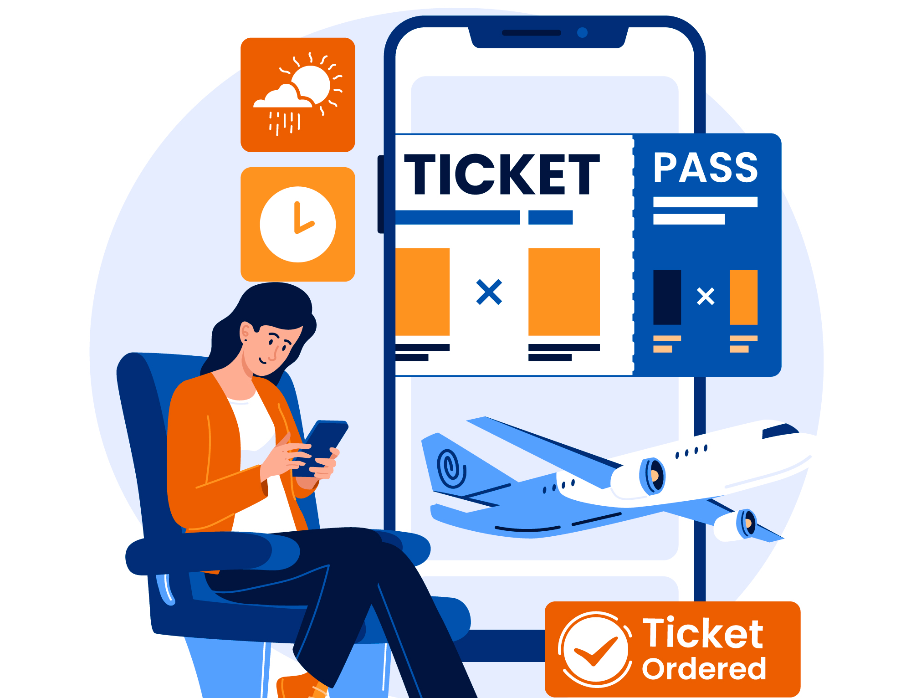
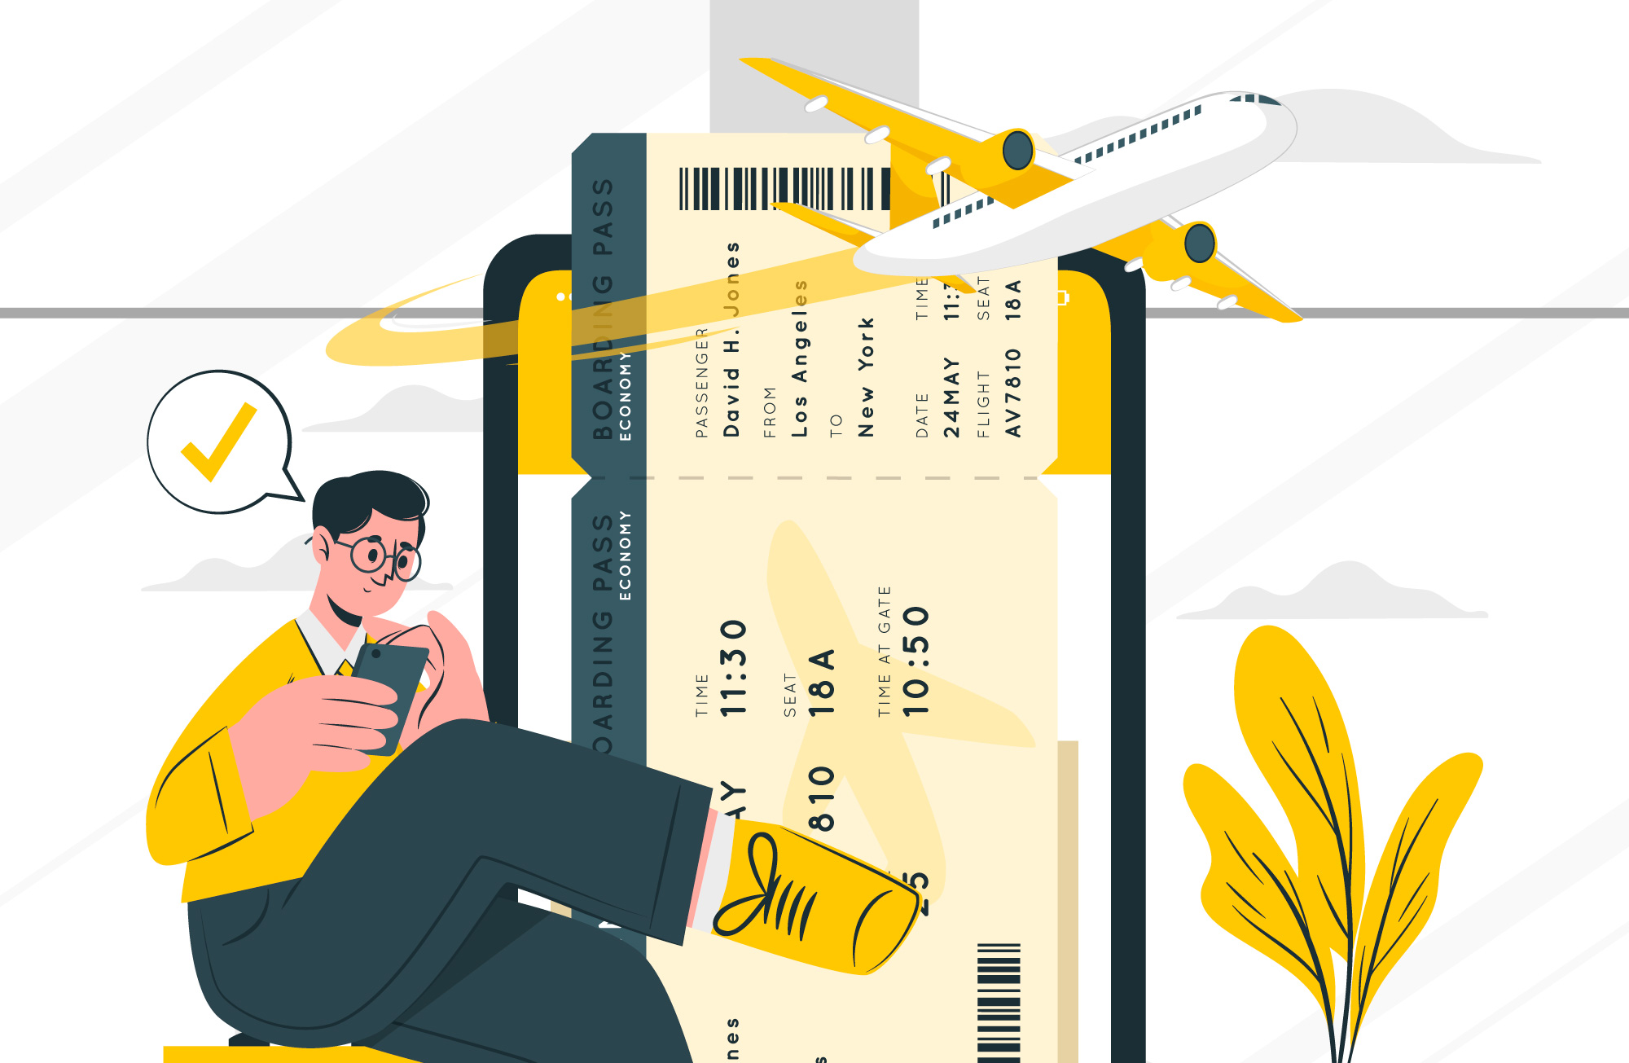
TICKET MANAGEMENT SYSTEM
Presented By:
TEAM: “DATA MINERS”
Submitted To:
Alif Ruslan
Lecturer, CSE, UAP

Slide 2
Our Group
Name | ID
Raj Kumar Saha | 23101065
Farhana Chowdhury | 23101066
Tithi Ghosh | 23101071

Slide 3
TABLE OF CONTENTS
Topic | Slide no
Introduction | 4
ER Diagram | 5
Entity Relationships | 6
Schema Diagram | 7
Entity Attributes | 8
Tables | 9 - 12
Queries and Outputs | 13 - 20
Conclusion | 21

Slide 4
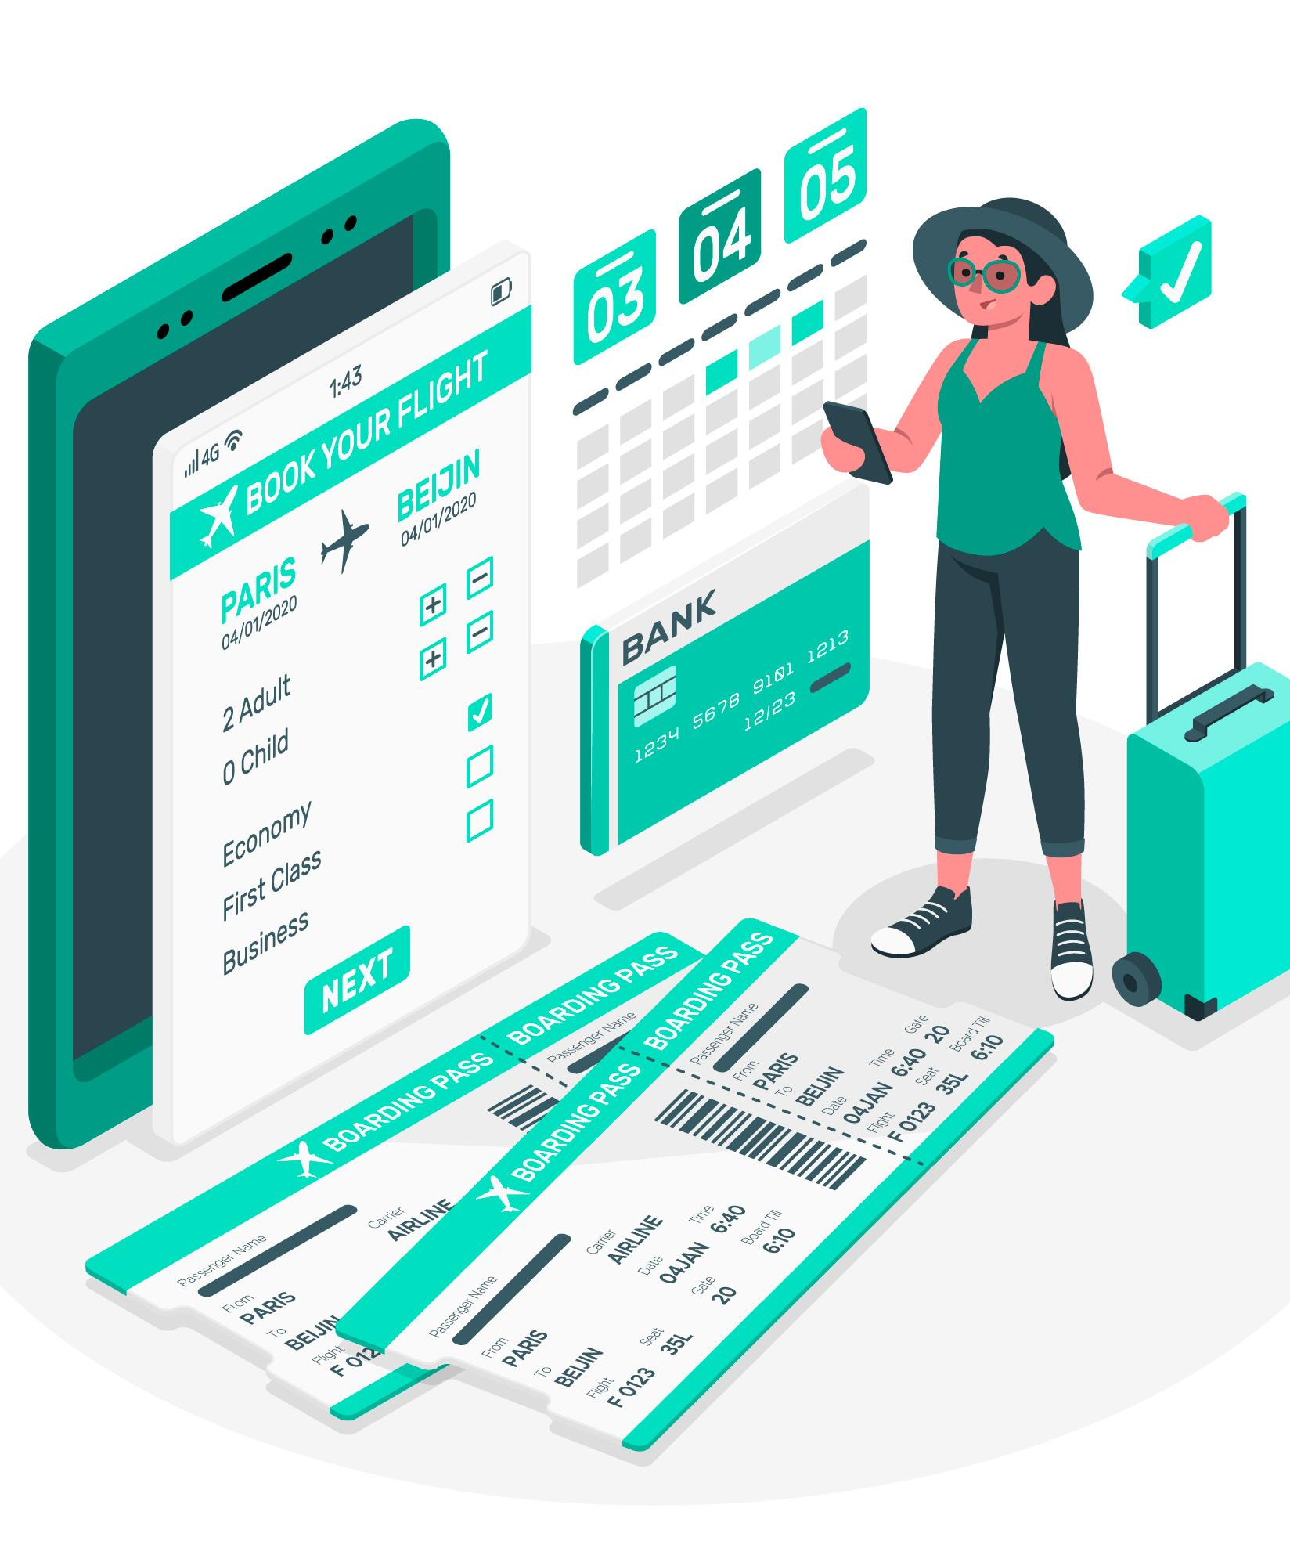
Introduction
This project is a Ticket Management System that allows users to purchase, manage, and resell tickets for buses, trains, and planes. Built using SQL, it includes modules for admins and customers and features a unique “Resell Ticket" system where users can sell their unused tickets to others. The goal is to create a centralized, efficient, and user-friendly ticket handling platform.

Slide 5
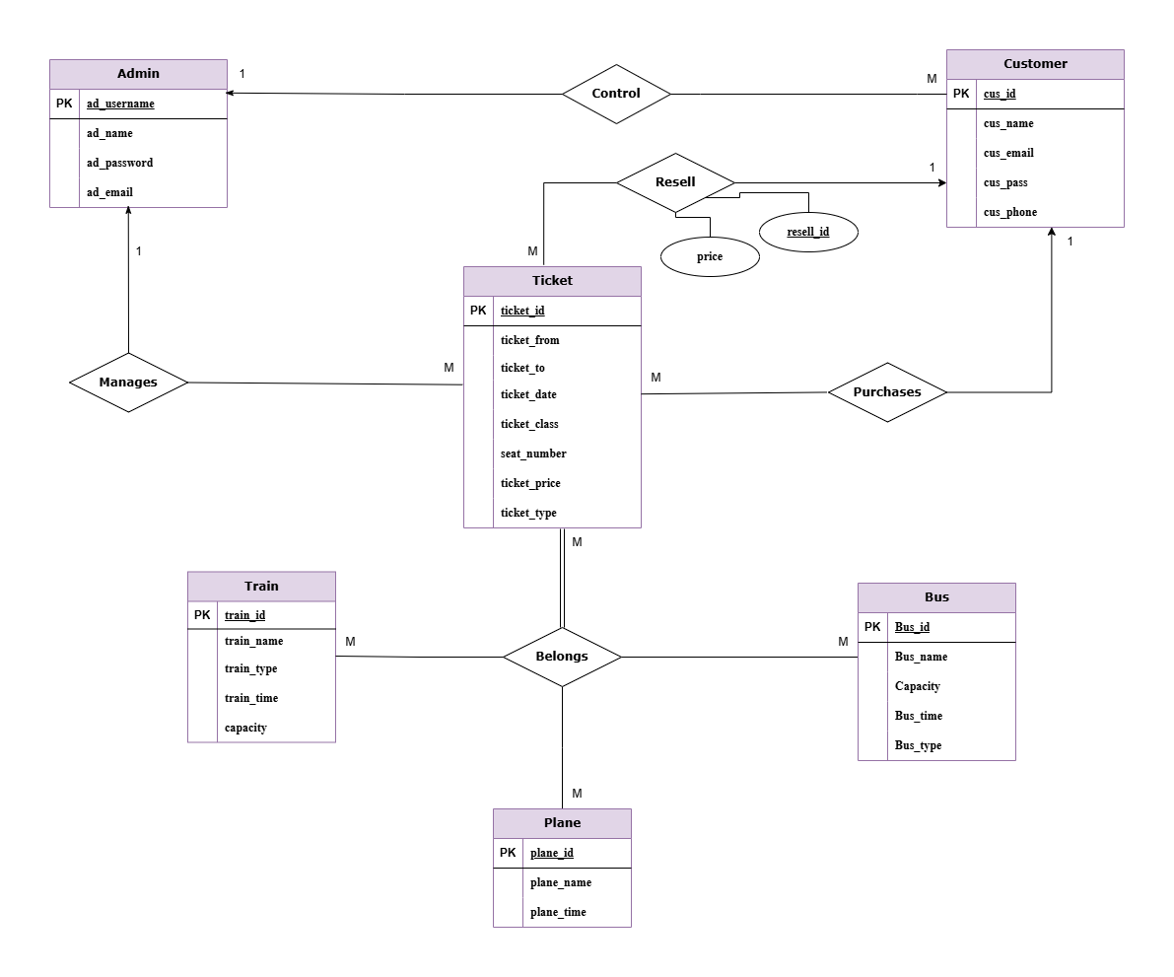
ERD I agram

Slide 6
Entity Relationships
1. Control :
Admin → Customer : (One-to-Many) → An admin can control many customers. Each customer is controlled by only one admin.
2. Manages :
Admin → Ticket : (One-to-Many) → An admin can manage many tickets. Each ticket is managed by only one admin.
3. Purchases : Customer → Ticket : (One-to-Many) → A customer can purchase many tickets. Each ticket is purchased by only one customer.
4. Resell :
Customer → Ticket : (One-to-Many) → A customer can resell many tickets. Each ticket is resold by only one customer with associated resell_id and price.
5. Belongs:
Ticket – Train : (Many-to-Many) → Many tickets can be associated with many trains. A single ticket can be valid for multiple trains, and a train can have multiple tickets issued for it.
Ticket – Bus : (Many-to-Many) → Many tickets can be associated with many buses. A single ticket can be valid for multiple buses, and a bus can have multiple tickets issued for it. Ticket – Plane : (Many-to-Many) → Many tickets can be associated with many planes. A single ticket can be valid for multiple planes, and a plane can have multiple tickets issued for it.

Slide 7
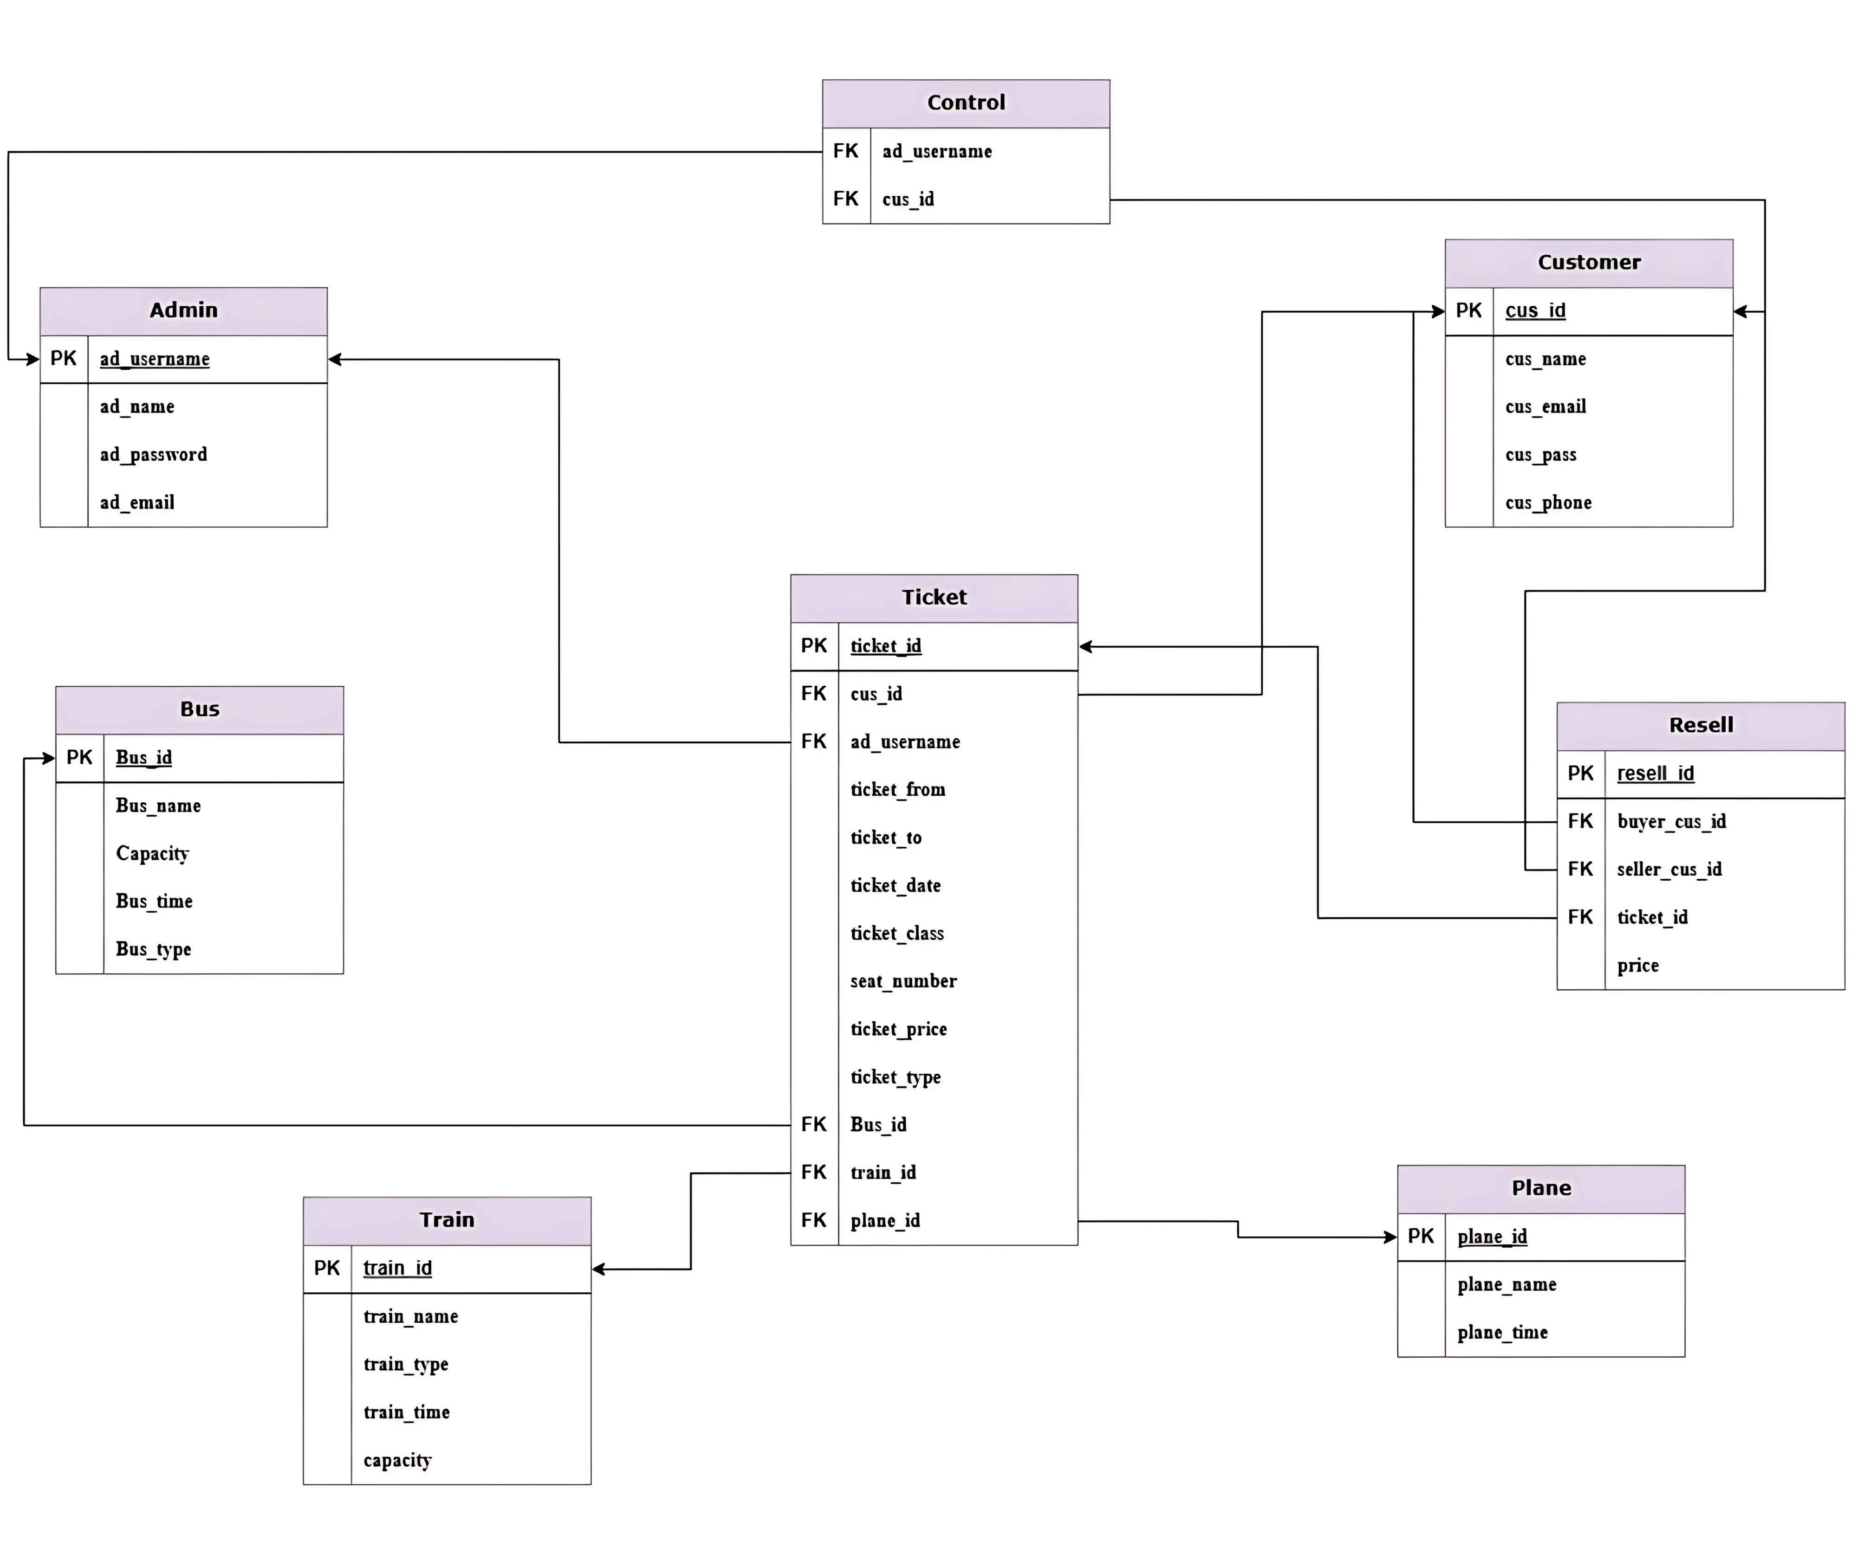
Schema Diagram

Slide 8
Entity Attributes
Admin: ad_username(PK), ad_name, ad_password, ad_email.
Customer: cus_id(PK), cus_name, cus_email, cus_pass, cus_phone.
Bus: Bus_id(PK), Bus_name, Capacity, Bus_time, Bus_type.
Train: train_id(PK), train_name, train_type, train_time, capacity.
Plane: plane_id(PK), plane_name, plane_time.
Ticket: ticket_id(PK), cus_id(FK), ad_username(FK), Bus_id(FK), train_id(FK), plane_id(FK), ticket_from, ticket_to, ticket_date, ticket_class, seat_number, ticket_price, ticket_type.
Control: cus_id(FK), ad_username(FK).
Resell: resell_id(PK), buyer_cus_id(FK), seller_cus_id(FK), ticket_id(FK), price.

Slide 9
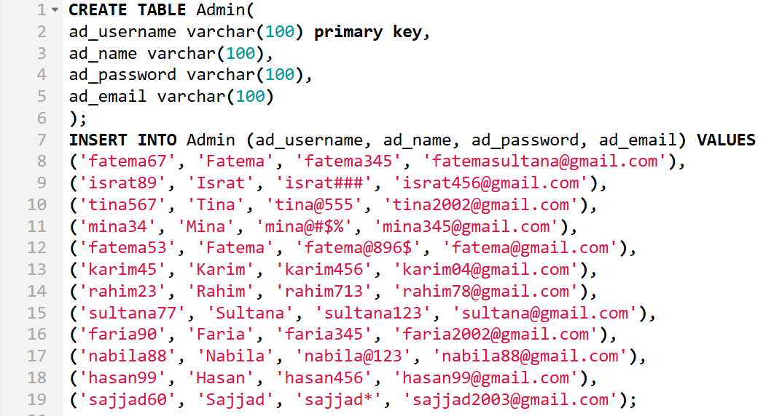
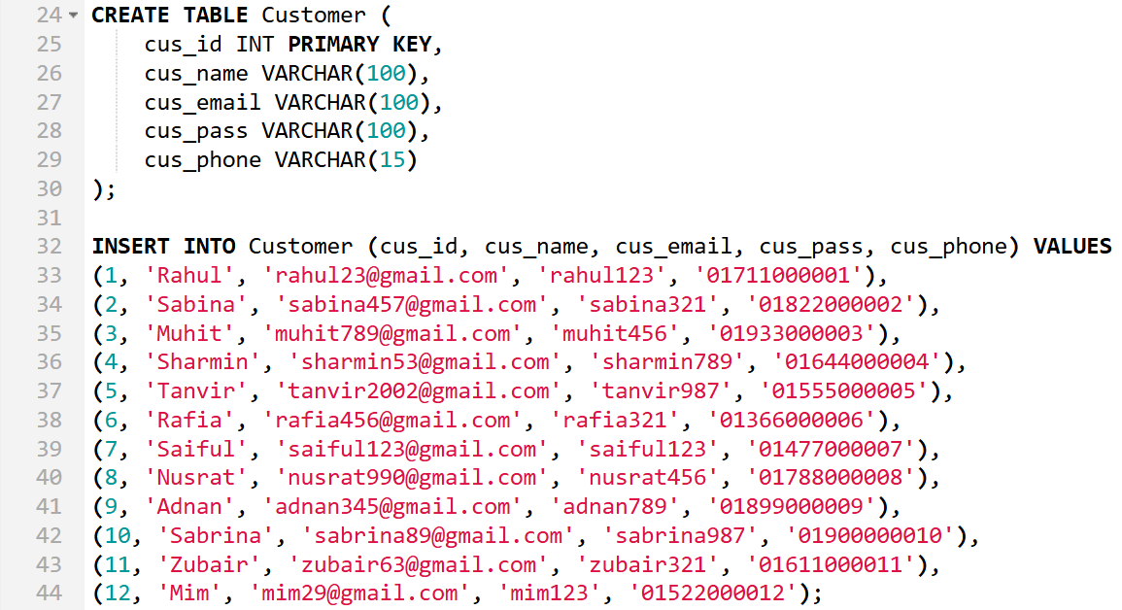
Tables

Slide 10
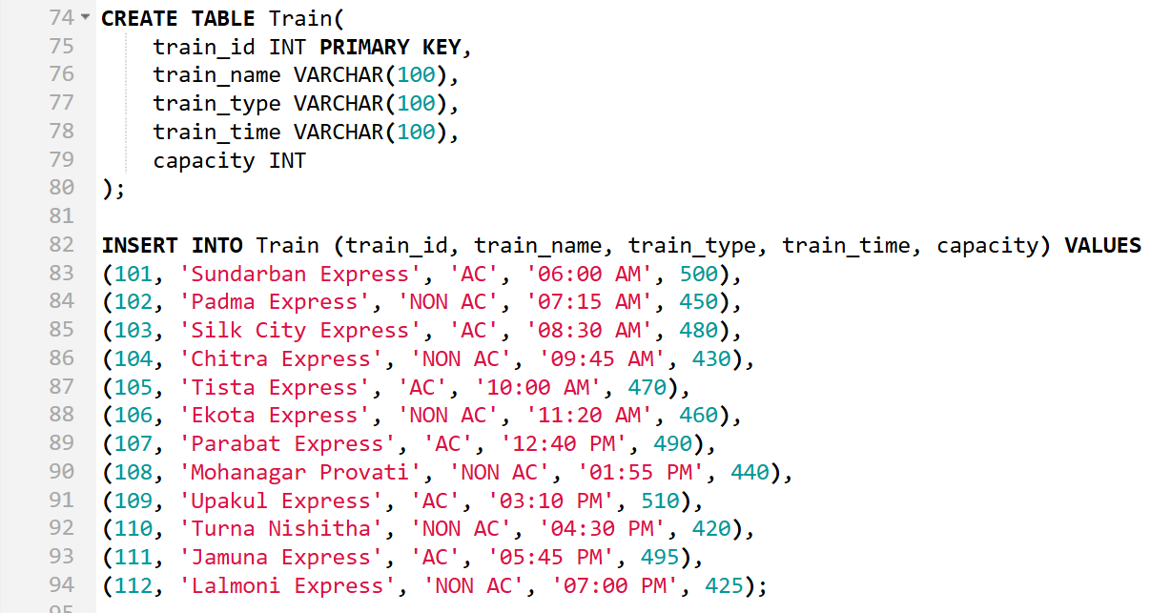
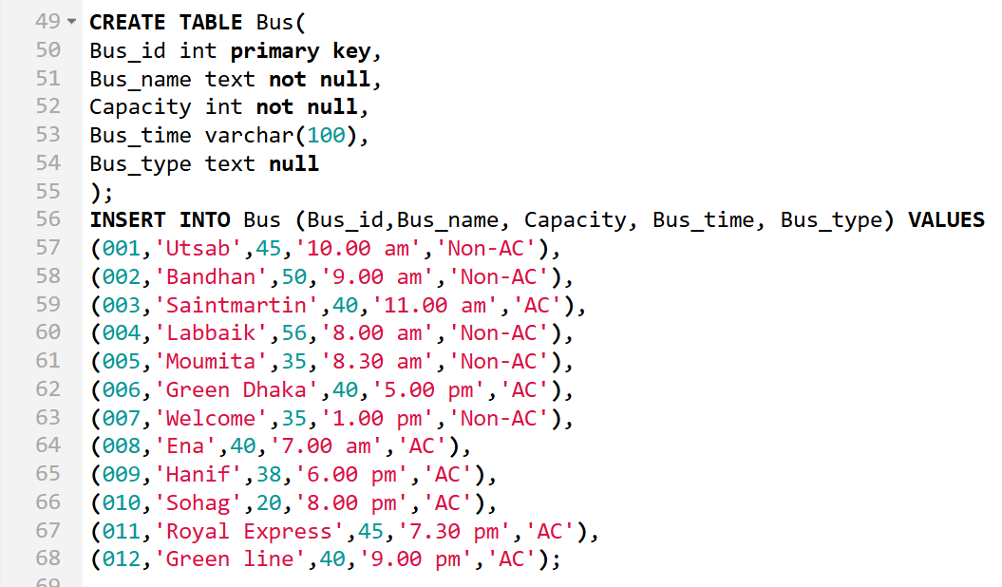
Tables Cont.d

Slide 11
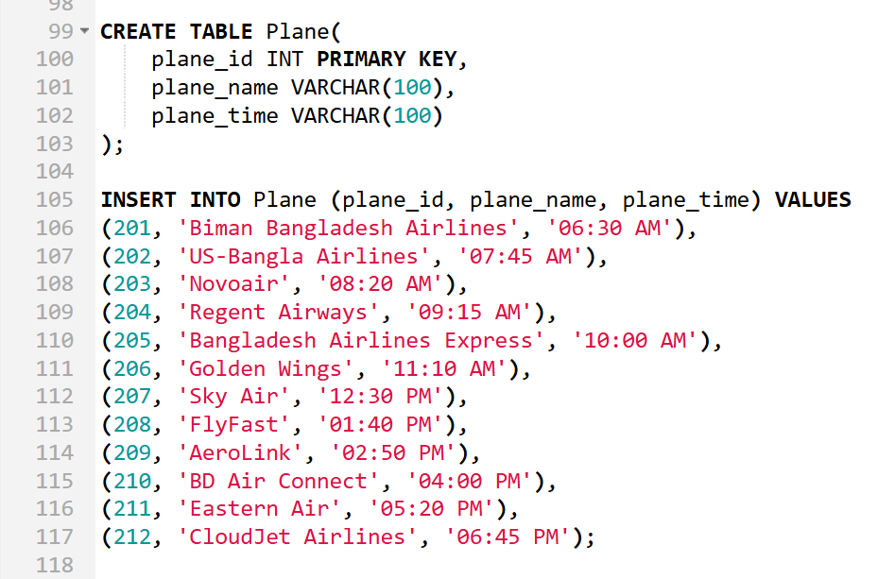
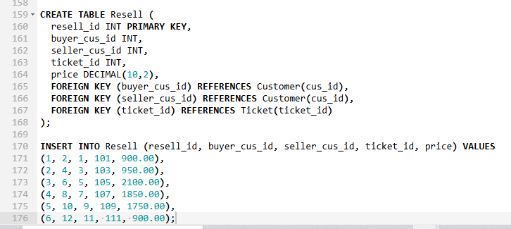
Tables Cont.d

Slide 12
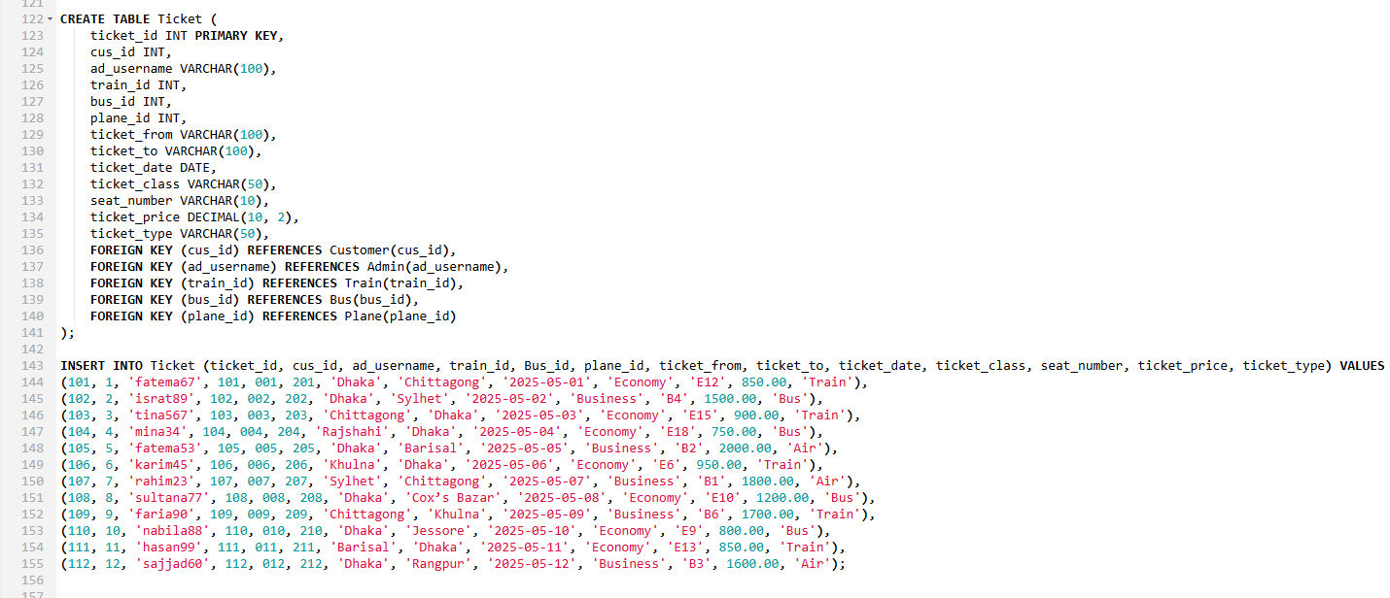
Tables Cont.d

Slide 13
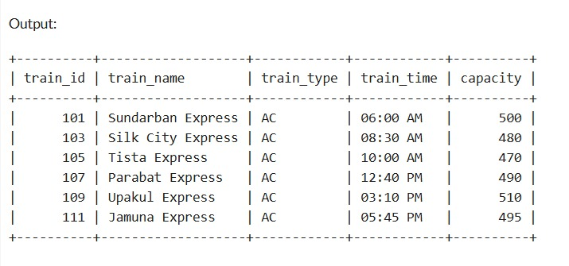
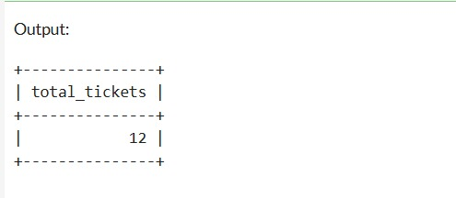
Queries and Outputs
1. Find all trains that are of AC type.
= SELECT * FROM Train WHERE train_type = 'AC';
2. Count total number of tickets.
= SELECT COUNT(*) AS total_tickets FROM Ticket;

Slide 14
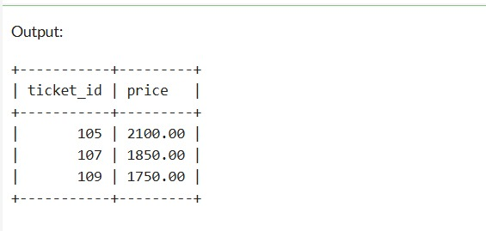
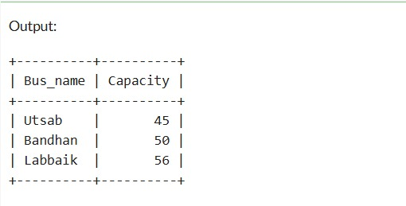
Queries and Outputs Cont.d
3. List the ticket IDs and prices for tickets resold for more than 1000 BDT.
= SELECT ticket_id, price FROM Resell WHERE price > 1000;
4. Find all the 'Non-AC' buses that have a capacity greater than 40.
= SELECT Bus_name, Capacity FROM Bus WHERE Bus_type = 'Non-AC' AND Capacity > 40;

Slide 15
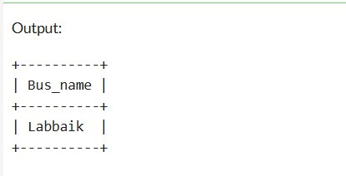
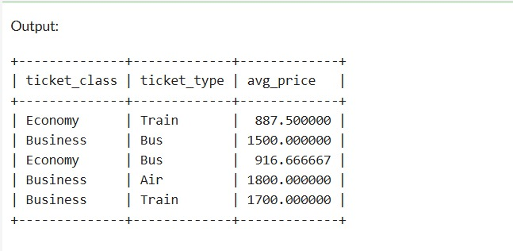
Queries and Outputs Cont.d
5. Find the name of the bus with the highest capacity.
= SELECT Bus_name FROM Bus WHERE Capacity = (SELECT MAX(Capacity) FROM Bus);
6. Get the average ticket price for each class (Economy/Business) and transportation type (Train/Bus/Air).
= SELECT ticket_class, ticket_type, AVG(ticket_price) AS avg_price FROM Ticket GROUP BY ticket_class, ticket_type;

Slide 16
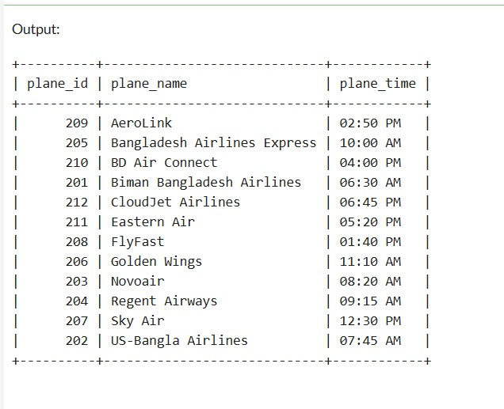
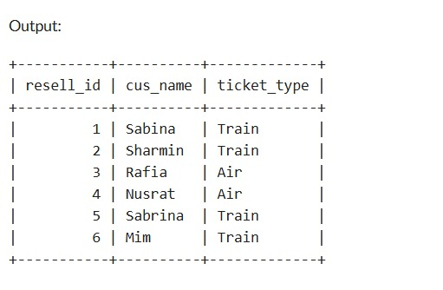
Queries and Outputs Cont.d
7. Show all the details of planes from the Plane table and sort them by the plane name in ascending order.
= SELECT * FROM Plane order by plane_name asc;
8. Show resold tickets with ticket type and buyer name.
= SELECT Resell.resell_id, Customer.cus_name, Ticket.ticket_typeFROM ResellJOIN Customer ON Resell.buyer_cus_id = Customer.cus_idJOIN Ticket ON Resell.ticket_id = Ticket.ticket_id;

Slide 17
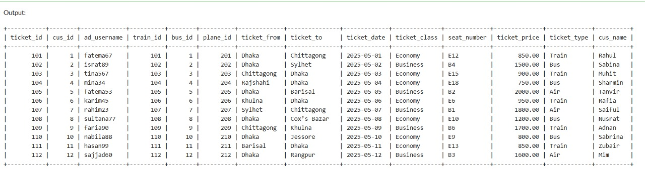
Queries and Outputs Cont.d
9. List all ticket details with customer names.= SELECT Ticket.*, Customer.cus_nameFROM Ticket JOIN Customer ON Ticket.cus_id = Customer.cus_id;

Slide 18
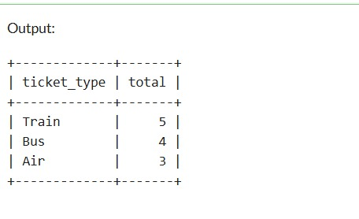
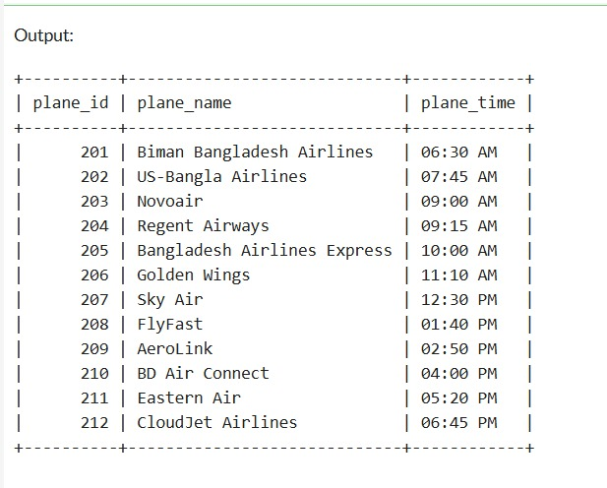
Queries and Outputs Cont.d
10. Total number of tickets sold for each transport type.
= SELECT ticket_type, COUNT(*) AS total FROM Ticket GROUP BY ticket_type;
11. Update plane time for plane_id 203.
= UPDATE Plane SET plane_time = '09:00 AM' WHERE plane_id = 203;SELECT * FROM Plane;

Slide 19
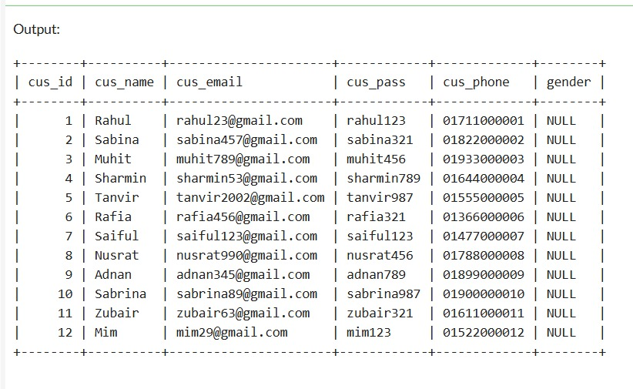
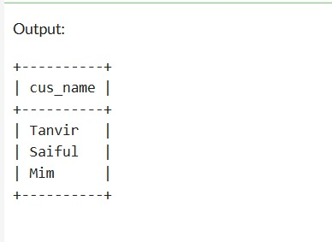
Queries and Outputs Cont.d
12. Add gender column to Customer table and show all data.
= ALTER TABLE Customer ADD gender VARCHAR(100);SELECT * FROM Customer;
13. Find names of customers who bought plane tickets.
= SELECT c.cus_name FROM Customer cJOIN Ticket t ON c.cus_id = t.cus_id WHERE t.ticket_type = 'Air';

Slide 20
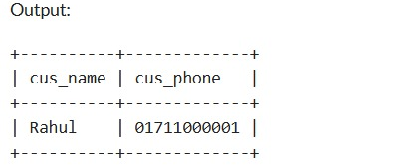
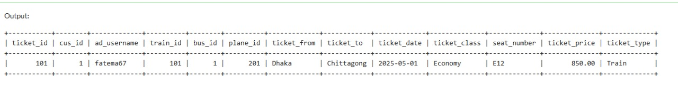
Queries and Outputs Cont.d
14. Find the customer names and their phone numbers who have a ticket for the plane 'Biman Bangladesh Airlines’.
= SELECT Customer.cus_name, Customer.cus_phone
FROM Customer JOIN Ticket ON Customer.cus_id = Ticket.cus_id
JOIN Plane ON Ticket.plane_id = Plane.plane_id WHERE Plane.plane_name = 'Biman Bangladesh Airlines';
15. List the tickets sold by Admin 'fatema67’.
= SELECT * FROM Ticket WHERE ad_username = 'fatema67';

Slide 21
Conclusion
In this Ticket Management System project, I have demonstrated the Entity-Relationship (ER) Diagram, Entity Relationships, Schema Diagram, Entity Attributes, Database Tables, Queries, and Sample Outputs.
This system is designed to make ticket booking and management more streamlined and efficient for passengers. With the added feature of Reselling of Tickets – Sell Your Commute, it empowers users to resell unused tickets, minimizing waste and helping others find last-minute seats.
Ultimately, this system provides a convenient and practical solution to everyday travel needs by saving time, reducing hassle, and offering flexibility for commuters.

Slide 22
THANK YOU
DO YOU HAVE ANY QUESTIONS?

